Slide 1

Clinical Resources, Week 3: The importance of psycholinguistic variables in anomia assessment
Marianne Casilio, MS, CCC/SLP
Gerasimos Fergadiotis, PhD, CCC/SLP
Notes:
Hi everyone, and thank you again for your participation in this study. Today I’m going to present our third clinical resource, which is titled “the importance of psycholinguistic variables in anomia assessment.” Again, my name is Marianne Casilio and I am working with Gerasimos Fergadiotis in the Aging and Adult Language Disorders lab at Portland State University.

Slide 2
Presentation Outline
Overview of four types of psycholinguistic variables
Influence of psycholinguistic variables on language tasks
Clinical assessment applications
Next week’s clinical resource
Notes:
For today’s presentation, which will be approximately 15 minutes long, I’ll start by briefly reviewing what psycholinguistic variables are and the types that we’re interested in with regard to picture naming and word production. Then I’ll discuss how each type of psycholinguistic variable impacts different language tasks. We’ll then close by reviewing a few clinical assessment applications and providing a preview for next week’s clinical resource.

Slide 3
Four types of psycholinguistic variables
Notes:
Let’s begin by reviewing what psycholinguistic variables are and the four types that we will be discussing during today’s presentation.

Slide 4
Psycholinguistic variables
Characteristics of a word that capture the complexity along one or more dimensions of language processing
Examples:
Number of letters, phonemes, or syllables
Written or verbal frequency of occurrence
Familiarity
Concreteness
Imageability
Age of acquisition
Part of speech
Morphological structure
Notes:
For those who may be unaware, we can define psycholinguistic variables as characteristics of a word that capture the word’s complexity along one or more dimensions of language processing. For example, the number of phonemes or syllables tell us about the phonological, or sound structure, of the word while the part of speech tells us about its syntactic construction.
There are several types of psycholinguistic variables, each of which is measured in unique ways.

Slide 5
Four psycholinguistic variables important to picture naming and other word production tasks
Variable | Definition | PNT examples
Frequency | how often a word occurs in the lexicon of a given language, measured as the log frequency per million occurrences in a written or spoken database * | book = 2.6375 pumpkin = 0.301
Imageability | how picturable a word is, measured as mean scores on a rating scale that range from 100-700 | banana = 644 pipe = 463
Length | number of phonemes in a word * | cake = 3 dinosaur = 7
Lexicality | the "real word" versus "nonword" status of a word | cat = real word. dæt = nonword
* can be measured in other ways than those listed here
Notes:
However, for the purposes of today’s presentation, we’re going to focus on psycholinguistic variables that are known to be important to picture naming and other word production tasks.
The four variables we’ll be focusing on are listed in the table on the screen. Starting with the top variable and going down the list, the first we’ll see is frequency, which is an estimate of how often a word occurs in the lexicon of a given language. This can be measured in several ways, but we’ll highlight one common way in which this is measured in the context of picture naming and the PNT, which is as the log frequency per million occurrences in a written or spoken database. An example of a written database may be the gigaword corpus, which consists of nearly every issue of the New York Times. An example of a spoken database is the subtlex corpus, which contains subtitles from American television shows and movies over several decades. This numerical value is highly helpful in teasing apart how frequently a person may be exposed to a given word or how often they use it in everyday communication. In thinking back to picture naming tests and the PNT, we can see that different targets occur at different frequencies – and as we can see by the examples on the screen, words like book occur far more frequently than others, such as pumpkin.
The second variable we’ll be considering is imageability. This variable captures how pictureable a word might be and is typically measured as a mean score across a rating scale, with values ranging from 100 to 700. Given that the PNT is necessitated on pictorial stimuli, there is not as much variation in this variable as, say, frequency, but we can see that the pictureability does vary somewhat, as we can see with the two examples, banana and pipe, on the screen.
The third variable we’ll talk about is length. Like frequency, this can be measured in multiple ways, but we’ll be defining this variable as the number of phonemes in a word and, again as we can see, the number of phonemes are varied in the PNT as well.
Finally, the fourth variable is lexicality, which we can define as the “real word” versus “nonword” status of a word and this can simply be measured by assigning a response or item into one of the two categories.

Slide 6
Influence of psycholinguistic variables on language tasks
Notes:
Now that we’ve reviewed what psycholinguistic variables are and which ones we’re interested in, let’s take a look at how these variables influence performance on language tasks in people with anomia due to aphasia.

Slide 7
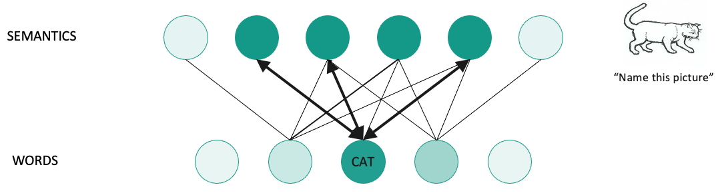
Picture naming: Frequency and Imageability
High frequency and high imageability words are easier to access because the stronger connections between the semantics and word levels
High frequency and high imageability words have no effect on phonological processing because access to phonemes does not require lexical-semantic information
Frequency effect Imageability effect
Notes:
For the purposes of today’s talk, we’ll be discussing frequency and imageability jointly, as they both tend to tap into the same linguistic process, which is lexical-semantic processing. As such, it is perhaps unsurprising that, on a picture naming task, high frequency and high imageability words are generally easier to access and thereby name. The reason for this is because high frequency and high imageability words generally have strong connections between the semantics and word levels of Dell’s model, which we reviewed over the last two weeks. This is visually depicted in the image toward the bottom of the screen, which shows the “strength” of those connections as bolded bidirectional arrows between the two levels. Importantly, you’ll notice that this figure does not include the phoneme level. This is because frequency and imageability do not affect phonological processing, as selecting and assembling sounds does not require use of lexical-semantic information, though, as we’ll discuss later on, strong lexical-semantic information can have a facilitative effect on phonological processing.
Importantly, when a distinct pattern is seen in naming with regard to frequency or imageability, where high frequency and high imageability words are named with greater accuracy than low frequency or low imageability words, we call this a frequency effect or imageability effect respectively.

Slide 8
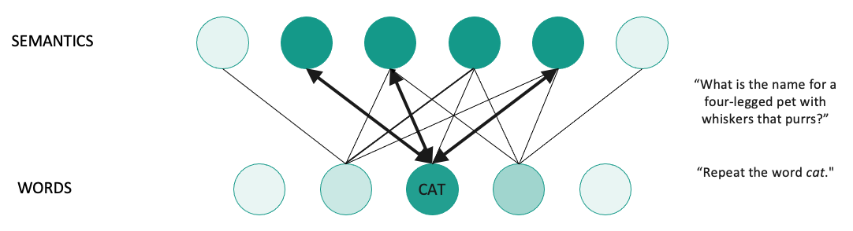
Other word production tasks: Frequency and Imageability
High frequency and high imageability words will be easier to name to definition because of stronger word-semantics connections
High frequency and high imageability words will be easier to repeat for individuals with phonological processing deficits because they can rely on strong word-semantic connections to boost phoneme encoding
Frequency effect Imageability effect
Notes:
Frequency and imageability affect other word production tasks, such as naming to definition and repetition, in different ways. Specifically, while high frequency and high imageability words make both of these tasks easier because of the stronger word-semantics connections, the two tasks produce different effects. For the naming to definition task, a frequency and imageability effect reflects problems with accessing those lexical-semantic connections because this task is heavily loaded on lexical-semantic processing. However, for the repetition task, which is typically a much lighter load with regard to lexical-semantic processing, a frequency or imageability effect can be seen in individuals with phonological processing deficits because they can rely on those stronger word-semantic connections as a means of boosting selection and assembly of phonemes.

Slide 9
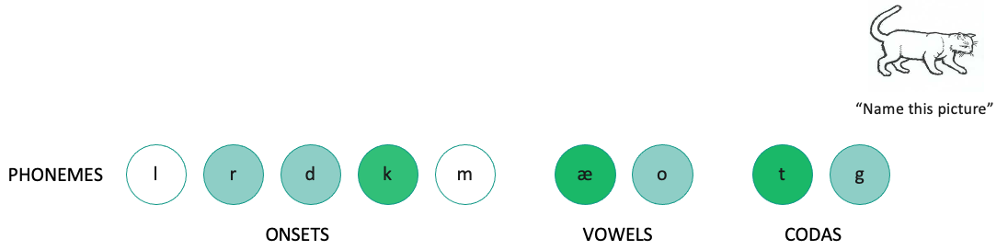
Picture naming: Length
The sounds in shorter words are easier to phonologically encode because there are fewer phonemes to select correctly
Shorter words have no effect on lexical-semantic processing because access to the semantics and word levels does not require phoneme information
Length effect
Notes:
Unlike frequency or imageability, length primarily affects the phonological processing of a word during a picture naming task. Put more simply, sounds in shorter words are easier to encode because there are fewer phonemes that need to be selected and assembled overall. The length of a word, however, does not impact lexical-semantic processing because connections between the word and semantics levels do not contain phoneme information and as such, are unaffected by this type of variable.
Finally, differential performance with regard to length can be called a length effect. In other words, a person who names shorter words more accurately than longer words would be said to demonstrate a length effect.

Slide 10
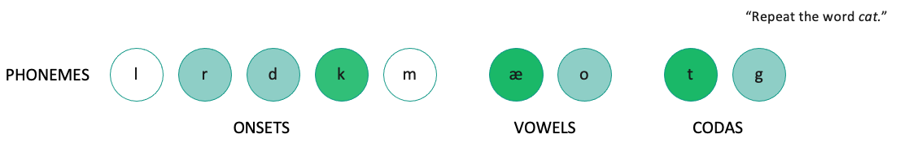
Other word production tasks: Length
Shorter words will be easier to repeat because of a decreased phonological load
Shorter words will not affect naming to definition because length does not decrease the lexical-semantic load required to do this task
Length effect
Notes:
This same pattern is seen in repetition tasks, where shorter words are also easier to repeat because of the decreased phonological load. And, similar to picture naming, shorter words generally do not affect performance on a naming to definition task because this task is primarily reliant on lexical-semantic processing , as opposed to phonological processing.

Slide 11
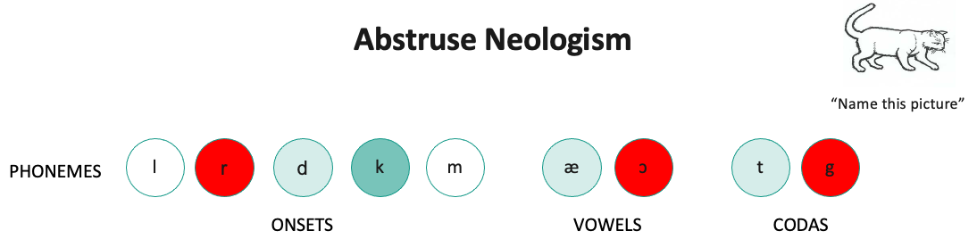
Picture naming: Lexicality
While lexicality is not manipulated on a picture naming task, nonlexical responses reveal a phonological processing deficit because lexical-semantic processing only involves access to real words
What if a nonlexical response also suggests a lexical-semantic deficit?
Notes:
Finally, lexicality is an important psycholinguistic variable but one that does not produce a specific effect in the context of a picture naming task, because lexicality cannot be manipulated. This is because picture naming tasks only contain real words. However, nonlexical responses, as we discussed last week, can reveal a deficit in phonological processing because lexical-semantic processing only requires access to real words.
This, then, raises an important question. How does one tell if a nonlexical response on a picture naming test is also the result of problems with lexical-semantic processing? This can commonly be seen in the case of abstruse neologism responses, where the resultant response may have few or no overlapping phonemes with the target.

Slide 12
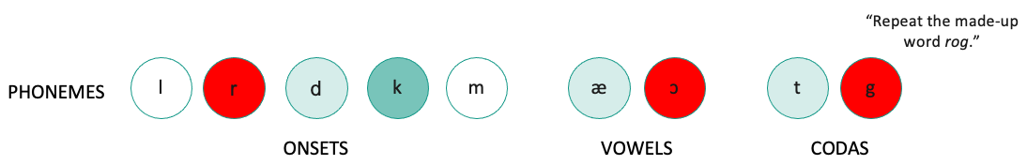
Other word production tasks: Lexicality
Lexical words are easier to repeat because of reliance of lexical-semantic information; nonlexical words are harder to repeat because this information does not exist
Lexicality cannot be manipulated for naming to definition
Lexicality effect
Notes:
Fortunately, this question can be answered by manipulating lexicality in other tasks and seeing if an effect is observed or not. This cannot be done with a naming to definition task because, as with a picture naming task, lexicality cannot be manipulated. However, repetition tasks allow for lexicality manipulation and, generally, lexical words are considered easier to repeat because of reliance on lexical-semantic information, as we discussed a few slides ago. Conversely, nonlexical words are considered harder to repeat because there is no lexical-semantic information to rely on. As such, if lexical words are repeated with greater ease than nonwords, it is called a lexicality effect. As to how this effect can be used to answer the question posed on the previous slide, we’ll return to this in a moment as we go over clinical assessment applications.

Slide 13
Clinical assessment applications
Notes:
Now that we’ve had a chance to look at how psycholinguistic variables produce effects that inform us about the location of breakdown across linguistic processes, we’ll review some ways this information can be applied to clinical assessment.

Slide 14
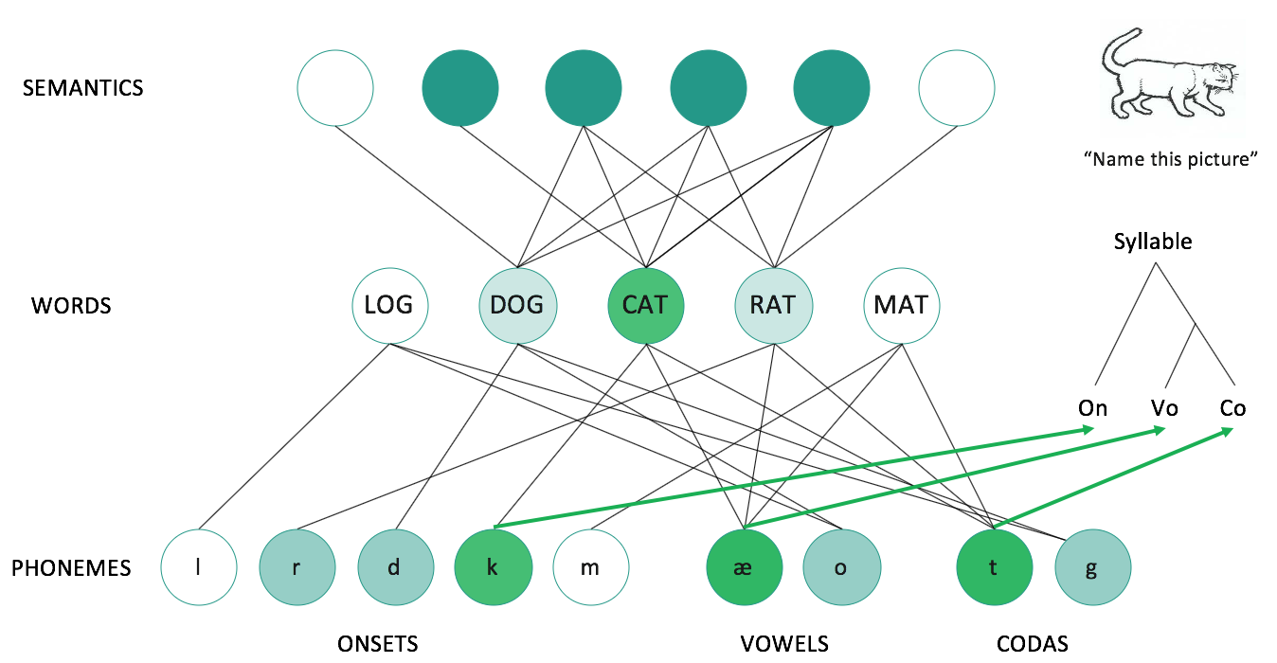
Manipulating psycholinguistic variables allows you to further test hypotheses regarding the location and degree of impairment.
Level of Impairment | Psycholinguistic effect
 | Frequency effect | Imageability effect | Length effect
Step 1: Lexical-semantic processing | ✓ | ✓ | ✗
Step 2: Phonological processing | ✗ | ✗ | ✓
Picture naming
Notes:
Similar to how we saw the type and prevalence of different paraphasias being informative in terms of identifying relative sparing or degree of impairment regarding lexical-semantic and phonological processing, psycholinguistic variables can provide additional information. The chart on this slide shows the location of breakdown according to each effect from the four psycholinguistic variables. Just to quickly reiterate, a frequency effect is when high frequency words are easier to name than low frequency words, an imageability effect is where high imageability words are easier to name than low imageability words, and a length effect is where shorter words are easier to name than longer words. The lexicality effect is not listed here because, as we reviewed earlier, it is not directly manipulated in a picture naming task. And, finally, as a quick reminder, the checkmark indicates the step where the breakdown occurs according to each effect.
Going left to right across the columns on the screen, we can see that frequency and imageability effects reflects a breakdown at step 1, lexical-semantic processing, while length effects reflect a breakdown at step 2, phonological processing.

Slide 15
Manipulating psycholinguistic variables allows you to further test hypotheses regarding the location and degree of impairment.
Level of Impairment | Psycholinguistic effect
 | Frequency effect | Imageability effect
Step 1: Lexical-semantic processing | ✓ | ✓
Step 2: Phonological processing | ✗ | ✗
Other word production tasks: Naming to definition
Notes:
For naming to definition, frequency and imageability are typically the only variables manipulated to determine if an effect exist. In both cases, a frequency effect or an imageability effect, where high frequency or high imageability words are named to definition with greater accuracy, are understood to reflect a deficit in step 1, or lexical-semantic processing.

Slide 16
Manipulating psycholinguistic variables allows you to further test hypotheses regarding the location and degree of impairment.
Level of Impairment | Psycholinguistic effect
 | Frequency effect | Imageability effect | Length effect | Lexicality effect
Step 1: Lexical-semantic processing | ✓ | ✓ | ✗ | ✗
Step 2: Phonological processing | ✗ | ✗ | ✓ | ✓
Other word production tasks: Repetition
Notes:
Finally, if we look at repetition, we can see that all four of the psycholinguistic variables can be manipulated to produce differing effects that reflect breakdown in either step 1, lexical-semantic processing, or step 2, phonological processing.
Importantly, returning to the question posed earlier regarding nonlexical responses and how psycholinguistic variables can be used to determine if both phonological and lexical-semantic processing deficit are present – one can manipulate lexicality in a repetition task and look for effects. Specifically, the absence of a lexicality effect on a repetition task, meaning that nonwords and real words are both repeated poorly, coupled with other forms of evidence for both a lexical-semantic and phonological deficit, such as a length effect on picture naming task, frequency and imageability effect on naming to definition task, would tell you that both processes are impaired.

Slide 17
Using psycholinguistic effects to confirm hypotheses and perform stimulability testing
Begin with a picture naming test and look at error patterns If administering the PNT or another test that has published psycholinguistic variables, look for different effect patterns among the responses
Administer additional word production tasks to clarify any areas of confusion
Task that isolates phonological processing: nonword repetition
Task that load heavily on lexical-semantic processing: naming to definition
Perform stimulability testing with additional picture naming items or other word production tasks
Pick items that are just above the range of the person’s ability on a given variable
Trial a cueing hierarchy depending on where the breakdown is suspected to see if this improves accuracy or results in responses that are closer to the target
Use selected items for outcome monitoring or as part of a treatment program
Notes:
Now that we’ve considered how the different effects across tasks can be used as a means of hypothesis testing to build a profile of strengths and weaknesses regarding linguistic processes, we can now discuss some possible ways in which this information could be used in the diagnostic progress.
Given that picture naming tests are easily accessible and typically included in most aphasia batteries, we would recommend starting with a picture naming test of some sort and looking at error patterns to begin building hypotheses about which processes are spared or impaired. This can be done in a number of ways, depending on time constraints, which we reviewed in last week’s resource.
If the picture naming test of interest is the PNT or another test with published psycholinguistic variables, these can be additionally examined to see if any patterns arise that confirm or deny those initial hypotheses.
If these two sources of information from the picture naming test do not reveal clear patterns, as may be the case with a client whose impairments are severe enough to obscure whether both lexical-semantic and phonological processing are impaired, as we discussed earlier, then additional word production tasks can be selected to test single linguistic processes more specifically. For example, nonword and real word repetition can both be administered to see if a lexicality effect emerges, which would serve to support a hypothesis of impairments in both lexical-semantic and phonological processing.
Then, finally, once all the necessary information has been obtained, the psycholinguistic variables can be used to select items for stimulability testing, which can be highly informative for treatment programming purposes. This can be done by first selecting items that are just above the client’s range of ability for a given variable. For example, if a client is found to have a phonological processing deficit and only correctly names items that are 4 phonemes or less, selecting items that are between 4 to 6 or 3 to 5 phonemes long may be appropriate. If desirable, a cueing hierarchy could also be trialed with these items to see if this facilitates performance in any way. Then, one stimulability testing has been completed, the items administered and results of this testing can be used either as a means of monitoring performance across treatment or as stimuli for the treatment itself.

Slide 18
Next week’s clinical resource
Notes:
Finally, we’ll now briefly reviewing next week’s material, which will build on the information we’ve reviewed here.

Slide 19
Next week: Scoring all other responses on the PNT
Overview of the remainder of the scoring protocol for the PNT
Scoring correct responses
Scoring miscellaneous responses
Scoring everything else
Clinical assessment applications
Notes:
For our final clinical resource, we will be providing information on how to score the remainder of the PNT with the aim of providing you with all the necessary information to successfully implement in your own practice should you be interested. We’ll start by reviewing the remainder of the scoring protocol and proceed to provide detailed information on the criteria for scoring correct response, miscellaneous-type errors, and the remainder of response types. Then, as with the previous clinical resources, we’ll wrap things up with discussing some applications to clinical assessment.

Slide 20
References for further review
Link to the International Naming Project: https://crl.ucsd.edu/experiments/ipnp/dataquery/querymini.php
Notes:
And that is it for this week’s resource! If you would like to learn more about the information presented today, we have included a link to a freely available database of picturable nouns and verbs that can be selected on the basis of different psycholinguistic variables. Should you like to create stimuli for your own picture naming assessment or outcome measure, as mentioned in the previous week’s clinical resource, or would like to create a targeted set of treatment items on the basis of psycholinguistic variables, this database may be a useful tool. Additionally, we are also sending you a file that contains multiple psycholinguistic variables for the 175 targets on the PNT.
And as always, thank you again for your time and attention!

